Slide 1
PHRENIC NERVE

Slide 2
Definition
“A long term ventilatory assisted individual(VAI) is a person who needs mechanical ventilatory assistance for more than 6 hrs. a day for more than 3 weeks after all acute illnesses have been maximally treated and in whom multiple weaning attempts by a expert respiratory care team have failed.” American Association of Respiratory Care
This excludes CPAP used for OSAS.

Slide 3
Negative pressure ventilators
They generate negative extrathoracic pressure. Negative pressure expands the thorax, producing a negative intra-alveolar pressure and consequent movement of air into the lungs.
Expiration is largely passive.
There are 3 different types
1) iron lung
2) cuirass
3) body wrap

Slide 4
The iron lung
large metal cylinder with flexible diaphragm operated by a piston rod at the distal end.
develops intra-tank pressure of up to -25 to -30 cmH2O and a respiratory rate between 10 and 30 breaths per minute.
most effective means of negative pressure ventilatory support, but it is quite large and is very uncomfortable for many patients.

Slide 5
The cuirass ventilator
consists of a rigid shell of either reinforced plastic or fiberglass which extend from the symphysis pubis to the suprasternal notch. sealed to the chest and abdominal walls with a flexible rubber diaphragm.
patient can be ventilated in either the sitting or supine position, therefore least confining of the negative pressure ventilators.
Due to the small tidal volumes not capable of providing complete ventilatory support in apneic patients.

Slide 6
The body wrap
consists of a one-piece plastic suit, a flat rigid plate, and a large plastic grid( which causes the negative pressure generated within the suit to be applied predominately to the thorax )
The body wrap is portable, lightweight and much more comfortable than the iron lung.
The body wrap does not allow access to the patient without interruption of ventilatory support, and generally only provides modest tidal volumes. It can only be used on patients who are not totally dependent on ventilatory support and can maintain unassisted ventilation for prolonged periods of time.

Slide 7
advantages
No tracheostomy needed.
The patient is also able to verbally communicate with family and medical personnel while being mechanically ventilated.

Slide 8
The disadvantages depend on the type of negative pressure ventilator being used.
not suitable for all patients.
Negative pressure ventilators cannot sustain adequate ventilation for prolonged periods in apneic patients.
regulation of inspiratory flow rates and cycle duration is not possible.
lncreased thoracic elastance may prevent generation of adequate tidal volumes.
The lack of complete accessibility to the patient impedes the performance of adequate chest physiotherapy.
The lack of control of the upper airway places patients with disorders of upper airway function at increased risk of aspiration of gastric contents and upper airway obstruction.
Therefore it is recommended that negative pressure ventilation only be used on those patients who do not have excessive secretion, markedly increased thoracic elastance, or disorders of the upper airway.

Slide 9
Positive pressure ventilators
Most modern portable and critical care ventilators use positive pressure to inflate the patient's lungs.
There are a number of home positive pressure ventilators ---LP-6 Ventilator, the Bear 33, the PLV-1OO, and the PB-28OO, just to name a few.
The basic outline is -- an internal and external battery source, a way in which to add oxygen to the patient's breathing circuit, a way to measure delivered and exhaled volumes and the ability to alert patient and/or caregivers of low patient pressures.

Slide 10
disadvantages
usually requires tracheal intubation (Tracheostomy)
incidence for barotrauma is greatly increased.

Slide 11
advantages
Adequate tidal volumes
smaller, reliable, and more portable than the hospital based ventilator.

Slide 12
Pacing techniques
PHRENIC NERVE
DIAPHRAGM
INTERCOSTAL MUSCLE

Slide 13
Phrenic nerve pacing
Phrenic nerve pacing, which uses and electrode implanted in the chest to stimulate the phrenic nerve, may benefit certain patients who are dependent on a respirator. The candidate must have normal phrenic nerve EMGs. The equipment required for phrenic nerve pacing is much smaller and more portable than a mechanical ventilator.
Phrenic nerve pacers improve respiratory physiology because air is drawn into the lungs naturally by diaphragmatic contractions, rather than air forced into the lungs under pressure from a mechanical ventilator.

Slide 14

Phrenic Nerve Pacing
Bi0108 - 30 April 03

Slide 15
Indications
spinal cord injury or disease, including quadriplegia
central alveolar hypoventilation
decreased day or night ventilatory drive (i.e. sleep apnea, Ondine's Curse)
brain stem injury or disease
damaged phrenic nerve(s)

Slide 16
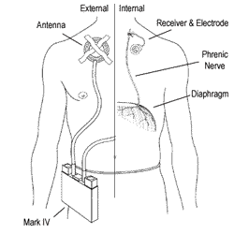
Device
The device provides electrical stimulation to the muscle and nerves that run through the diaphragm. When the muscle is stimulated, it contracts, causing a vacuum-like effect in the chest cavity that causes air to enter the lungs. When the contraction eases, the air is expelled passively. This process is repeated 10-14 times per minute. This is essentially the same process as normal breathing.
biomed.brown.edu

Slide 17
Device (cont.)
The pacing system consists of:
Four Teflon embedded Electrodes: deliver a pulse directly to the phrenic nerve causing the diaphragm muscle to contract.
  The quadripolar system sequentially stimulates each of the four electrodes during a given breath, thereby decreasing the number of impulses delivered to a single quadrant of the phrenic nerve by 75% during inspiration. This quadripolar electrode system aims to eliminate the potential for diaphragm fatigue with prolonged pacing and allow for the situation-specific manipulation of pacer settings to meet the needs of an individual through stimulation setting changes by programming modules and the stimulus controller.

Slide 18
Device (cont.)
Platinum/Stainless Steel Leads: connect the electrodes to the receiver and transmitter
Radio receivers: translate the radio waves and stimulate the pulses.
  The radio receiver has a connector that is screwed into a titanium disc with an axial flange covered entirely by a woven double velour patch, which provides a barrier to infection.
  The electrode wires are crimped to the connector and embedded in silicone rubber.
External transmitter/antenna assembly (portable control unit): receives its power from 9 volt batteries and sends energy and stimulus information to the patient’s receiver implant.

Slide 19
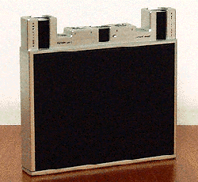
Mark IV Transmitter
Mark IV Transmitter already in PMA phase has many advantages over the current model (S-232G)
Bilateral redundancy, including dual batteries
The bilaterally redundant design of the Mark IV provides greater safety than the S-232G transmitter.
biomed.brown.edu

Slide 20
Benefits Over Mechanical
Ventilation
Breathing is more physiologic
Resumes sense of smell, taste and normal speech (although the fixed respiratory rate is a disadvantage for fluent speech)
Saves about $1000 per month that would go toward maintenance and disposables for mechanical ventilation
Easier for caregivers, Increased quality of life
cost effectiveness because patients can live outside of hospitals and the cost of a ventilator and its disposables is eliminated.

Slide 21
Benefits Over Mechanical
Ventilation (cont.)
lower infection rate due to reduction in suctioning, elimination of external humidifier and ventilator circuits, and the possibility of tracheostomy tube removal (some patients have had their tracheostomy closed).
improved venous return (negative, not positive pressure).
normal breathing and speech.
ease of eating and drinking.
increased patient mobility.
unobtrusive use due to the small size of external components and totally silent operation.

Slide 22
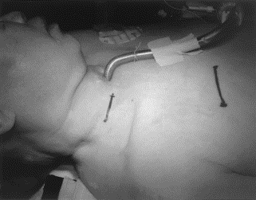
Surgical Procedure
A small (4cm) incision is made just above the clavicle. The subcutaneous tissue is dissected down until the anterior scalene muscle has been exposed.
biomed.brown.edu/Courses/BI108/BI108_2003

Slide 23
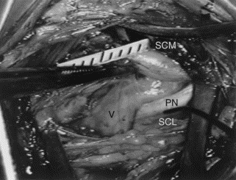
Surgical Procedure (cont.)
Assisted by monopolar electrical stimulation, the phrenic nerve is identified over the scalene muscle.
The nerve sheath of the phrenic nerve is carefully exposed for about 1cm through an operative microscope.
biomed.brown.edu/Courses/BI108/BI108_2003

Slide 24
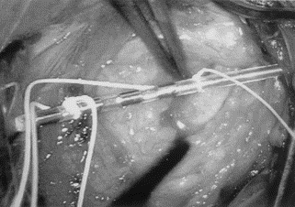
Surgical Procedure (cont.)
The electrode lead is place along side the nerve and fixed to the surrounding connective tissues with two sutures.
biomed.brown.edu/Courses/BI108/BI108_2003

Slide 25
Surgical Procedure (cont.)
A second incision is made into the anterior upper chest, and the receiver placed subcutaneously. The lead is then tunneled and from the electrode down to the receiver.
Both incisions are closed, and the procedure is then repeated on the other side of the chest.
Patients are always placed in the Intensive Care Unit for management of their ventilation
Prophylactic antibiotics are continued for 48 hours

Slide 26
Surgical Risks
Invasive surgery carries increased risk of infection, as does long hospital stay
High risk of damage to the phrenic nerves due to phrenic nerve dissection and electrode placement

Slide 27
Conditioning
Because the patients have atrophied diaphragm muscle, doctors must condition the muscle after the device is implanted before the patients can be weaned from the ventilator.
Conditioning is achieved by electrically stimulating the diaphragm for 10 to 15 minute intervals until the muscle is rendered capable of responding to the external battery control of the device for extended periods of time.

Slide 28
Demographics
Approximately 1,000 people have received this procedure world wide.
Manufacturer: Avery Labs – FDA approved device
183,000-230,000 people with spinal cord injury in the Unites States.
On average there are 11,000 new cases of spinal cord injury per year.
  Nearly 52% of spinal cord injuries are at the cervical level.
  Nearly 20% of patients will require mechanical ventilatory support.
  Approximately 5% (200-400 per year) are patients who cannot be weaned off mechanical ventilation by natural means and will therefore require chronic mechanical ventilation.

Slide 29
Costs
Cost of procedure is $100,000.00
  Cost is covered by Medicare, Medicaid, and many private insurance companies
  This might actually be a cheaper alternative to mechanical ventilation, due to decreased cost of care
Cost of device: $40,000-$50,000

Slide 30
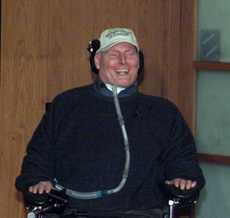
“[Phrenic pacing] is a drastic and dangerous procedure. The risks are enormous. Batteries fail. The procedure frees you from the ventilator, but the outcome can be fatal.”
- Christopher Reeves. Still Me

Slide 31
Laproscopic Phrenic Nerve Pacing Technology
Developed by Case Western Reserve University bio-medical engineers and physician researchers
The new laproscopic diaphragm pacing is a much less invasive, outpatient procedure. Instead of stimulating the phrenic nerve in the neck region, the electrodes are connected to the motor points of the diaphragm. This offers many benefits over the current phrenic nerve pacing, including lowered costs and decreased risks.

Slide 32
Criteria for Eligibility
Respiratory failure for the past six months that requires chronic mechanical ventilatory support.
Failure of vigorous attempts to wean from ventilatory support.
Normal bilateral phrenic nerve function is required.
No active cardiovascular disease, no active lung disease, no active brain disease, no significant scoliosis, no chest wall deformity, no obesity.

Slide 33
Procedure Part I - Implantation
Wires are threaded through four small incisions
These wires connect 4 electrodes directly onto the diaphragm. The electrodes are not placed directly onto the phrenic nerve.
3. stainless steel electrodes are placed on each motor point of the diaphragm, using a specially designed delivery device that allows for the insertion of the electrodes in the same plane as the diaphragm. (The motor point is the place at which the phrenic nerve attaches to the diaphragm in order to cause movement.)

Slide 34
Implantation (cont.)
A laparoscope and a previously designed mapping procedure is used to determine exactly where on the diaphragm these motor points are.
The wires are brought out of the body and connected to an external battery/control that automatically sends mild currents to the electrodes inducing a natural breath. This battery is replaced every week.
Breathing is induced 12 times per minute. This is normal breathing rate.
This procedure is done on an outpatient basis.
Similarly to the current procedure, the patient’s diaphragm requires conditioning.

Slide 35
Benefits of Laporoscopic Phrenic Nerve Pacing
Decreased cost ($10,000.00 vs $100,000.00)
Much less invasive procedure.
Decreased risk-Direct stimulation of the phrenic nerve may damage the nerve. Laporoscopic phrenic nerve pacing does not place the electrodes in direct contact with the phrenic nerve.
Less risk of infection because of smaller incisions.

Slide 36
The Future
The enhanced ability for the pacemaker to respond automatically to the body based on physiological signals. For example during speech vs. during relaxation.
Internalize the entire device thereby reducing susceptibility to infection.
  With use of a battery that can be recharged through the skin.
  With a battery that can continue without the need to be recharged for a minimum of ten years.
Perhaps with the arising benefits of stem cell technology to regenerate damaged nerves or tissues, the phrenic nerve pacemaker will be made available to patients who are currently considered ineligible for this device due to extensive phrenic nerve damage.

Slide 37
Thank you

